Slide 1
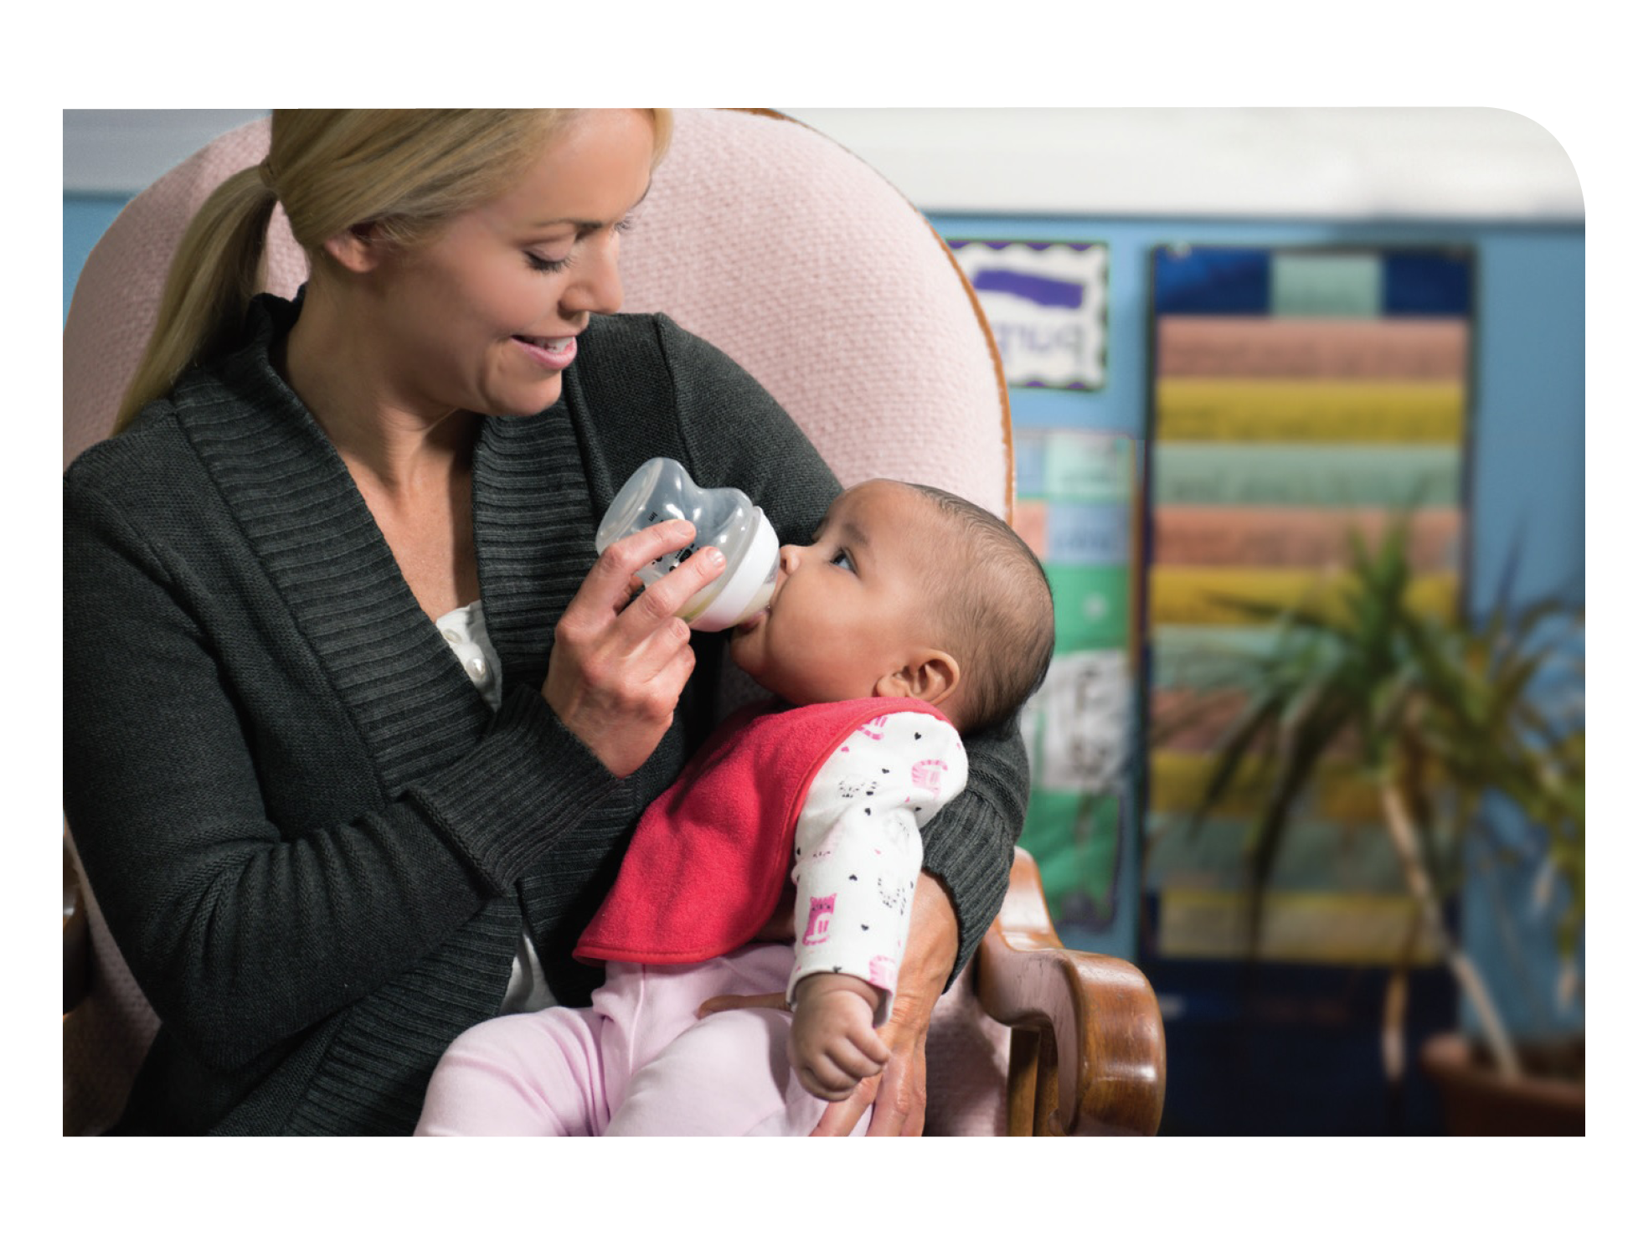
Feeding Infants in the CACFP
Lesson 5
Selecting, Storing, and Handling Infant Formula in a Child Care Site
Notes:
Information in this lesson comes from Chapter 3: Feeding the Formula-Fed Baby and Chapter 4: Handling and Storing Breastmilk and Infant Formula in the Feeding Infants in the Child and Adult Care Food Program guide. In this lesson, participants learn about best practices for selecting, storing, and handling infant formula.
Learning Objectives
At the end of this lesson, participants should be able to:
Describe how to select an iron-fortified infant formula to offer at their child care site.
Describe how to safely store infant formula.
Identify how to prepare infant formula for feeding.
Lesson Description
The Selecting, Storing, and Handling Infant Formula in a Child Care Site lesson takes approximately 20 minutes to deliver. If the pre-test and post-test are administered, total session time will be approximately 25 minutes.
Welcome and Trainer Introduction
Welcome participants to the training and introduce yourself by providing:
Your name
Your position title
Your experience with the CACFP, infant nutrition, and/or child care.

Slide 2
Agenda
Selecting Infant Formula
Handling and Storing Infant Formula
Communicating With Parents
Summary
Notes:
In this lesson, you will learn best practices for selecting, storing, and handling infant formula at a child care site and ways you can share and gather information from parents about iron-fortified infant formula.

Slide 3
Pre-Test
3
2
1
Yes or No?
A child care provider has been busy watching all of the children in his care and accidentally leaves a bottle of infant formula out on the counter for 2½ hours. Can he put it back in the refrigerator and use it later?
Notes:
Yes or No?
A child care provider has been busy watching all of the children in his care and accidentally leaves a bottle of infant formula out on the counter for 2½ hours. Can he put it back in the refrigerator and use it later?
Trainer Note: You can conduct the pre-test as a group activity or distribute a paper test. There are three question slides.
For a group activity, ask participants what they think the answer is for each question.
Do not give the answer.
Tell participants that the answer to each question will be provided during the lesson and the answers will be provided at the end of the lesson in the post-test slides.
For paper-based testing, distribute the pre-test and pencils. Tell participants how much time they have to complete the assessment.
If you will not administer the test, skip the slide.

Slide 4
Pre-Test
3
2
Bottles of infant formula can be refrigerated at 40 ºF (or below) for up to _____ hours.
24
36
48
72
Notes:
Bottles of infant formula can be refrigerated at 40 °F (or below) for up to _____ hours.
24
36
48
72
Trainer Note: The answer to the question will be provided in the content of the lesson and is provided in the post-test slide.

Slide 5
Pre-Test
3
Yes or No?
A mother brings in a new iron-fortified infant formula for her baby. The child care provider has worked with babies for years and prepares the infant formula the same way she does with all other formulas. Is the child care provider preparing the infant formula correctly?
Notes:
Yes or No?
A mother brings in a new iron-fortified infant formula for her baby. The child care provider has worked with babies for years and prepares the infant formula the same way she does with all other formulas. Is the child care provider preparing the infant formula correctly?
Trainer Note: The answer to the question will be provided in the content of the lesson and is provided in the post-test slide.

Slide 6
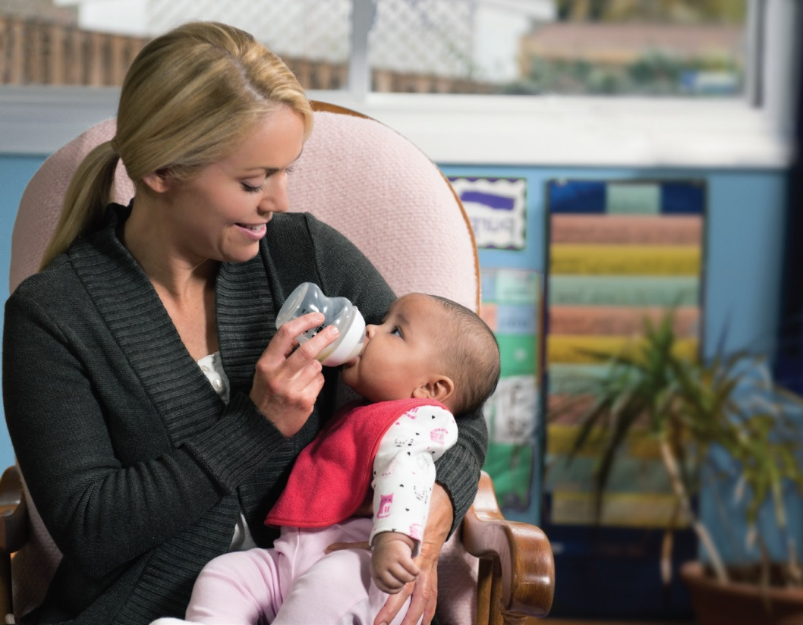
Selecting Infant Formula
You must offer at least one iron-fortified infant formula.
Must be regulated by the FDA.
Notes:
To ensure infants are getting the nutrients they need for healthy growth, the U.S. Food and Drug Administration (FDA) has strict nutrition and safety standards for infant formula. In the CACFP infant meal pattern, you must offer at least one iron-fortified infant formula that is regulated by the FDA to babies who are not breastfed or are partially breastfed. All infant formulas sold in the United States are regulated by the FDA. If an infant formula is bought from a place online or in person outside of the United States, it is probably not regulated by the FDA and should not be used.
Although you must offer at least one iron-fortified infant formula, the type of infant formula fed to a baby is a decision that should be made by the baby’s parents and health care provider.

Slide 7
Purchasing Iron-Fortified Formula
Notes:
Trainer Note: This is a good time to pass around the supplemental materials: various types of containers of iron-fortified infant formula or Nutrition Facts labels. Discuss what child care providers should look for on container labels when purchasing infant formula.
Look for “Infant Formula with Iron,” or a similar statement on the front of the formula container.
Use the Nutrition Facts label as a guide to make sure the formula has enough iron.
To be considered iron-fortified, an infant formula must have 1 milligram (mg) of iron or more per 100 calories of formula when prepared using the label directions.

Slide 8
Babies With Special Dietary Needs
If a baby will be fed:
Non iron-fortified formula
Low- or no-iron formula
Must have a signed medical statement for formula substitution to be reimbursed in the CACFP.
Low Iron
Notes:
There are different reasons for parents to choose a specific formula. Parents may choose to provide a formula because of an allergy or intolerance, for religious reasons, or if they want a vegan diet for their baby.
Trainer Note: Refer participants to the Soy-Based, Low Lactose, and Lactose-Free Formulas section in Chapter 3: Feeding the Formula-Fed Baby of their Feeding Infants in the Child and Adult Care Food Program guide on page 36 for more information about soy-based, low-lactose, and lactose-free formulas.
If a baby will be fed a formula that is not iron-fortified or is a low- or no-iron formula, the substitution must be supported by a signed medical statement for it to be creditable in the CACFP.

Slide 9
Medical Statement
The medical statement must include:
Name of infant formula to be avoided,
Explanation of how formula affects the baby, and
Health care provider’s signature.
Recommended formulas a baby can have may be included.
Keep the medical statement on file in a secure location at your child care site.
Notes:
The medical statement must include the name of the infant formula to be avoided, explain how the infant formula affects the baby, and be signed by the baby's health care provider.
Recommended substitutions of infant formula can also be included on the medical statement.
Keep the medical statement on file in a secure location at your child care site.

Slide 10
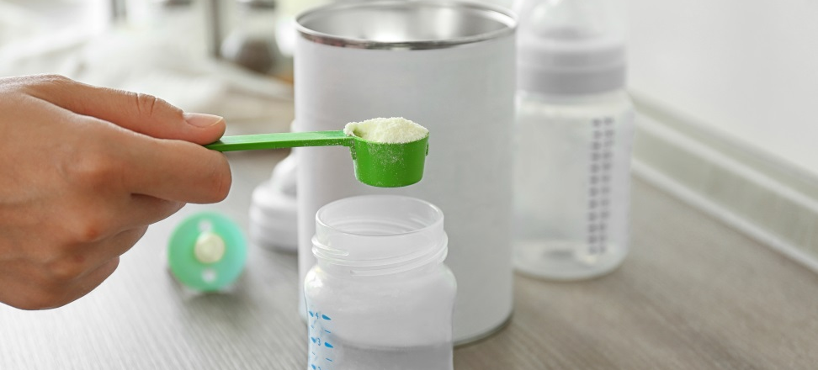
Preparing Formula
Provide Minimum Amount for Baby’s Age
Read and follow instructions on the container of infant formula.
Use the scoop provided with the container.
0 through 5 Months
  4–6 fl. oz. / Meal
  4–6 fl. oz. / Snack
6 through 11 Months
  6–8 fl. oz. / Meal
  2–4 fl. oz. / Snack
Notes:
Trainer Note: This is a good time to pass around the supplemental materials: various types of bottles, labeled with and without babies’ full name and date.
Prepare, use, and store infant formula according to the product instructions on the container or as directed by the baby’s health care provider.
The instructions for preparing infant formula are different for each product.
For powdered formula, measure the amount of formula using the scoop provided with the container.
The water used for preparing infant formula should be routinely tested for lead and other unsafe contaminants.
Fill bottles with at least the minimum amount of infant formula required in the CACFP infant meal pattern.
For breakfast, lunch, and supper:
Babies 0 through 5 months need 4 to 6 fluid ounces.
Babies 6 through 11 months need 6 to 8 fluid ounces.
For snack:
Babies 0 through 5 months need 4 to 6 fluid ounces.
Babies 6 through 11 months need 2 to 4 fluid ounces.

Slide 11
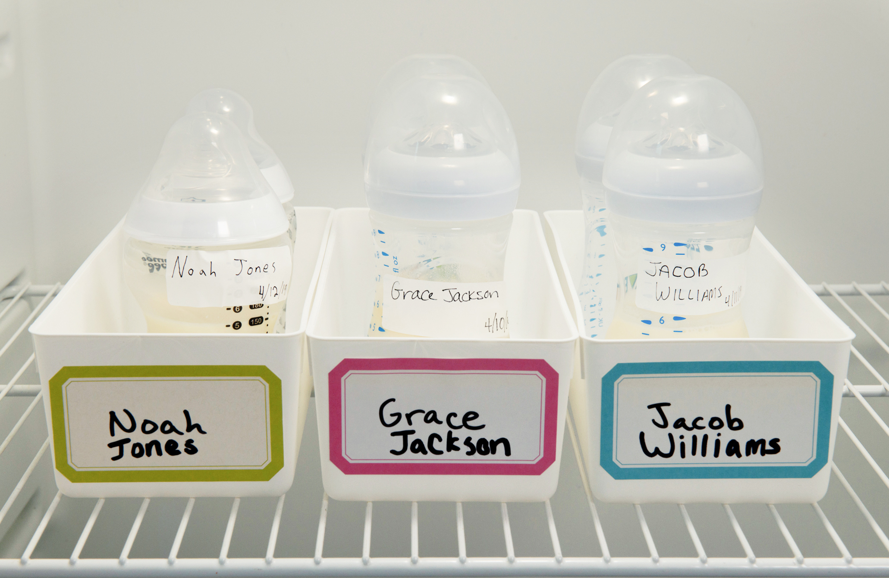
Storing Formula
Refrigerate at 40 ⁰F (or below).
Remove from refrigerator no more than 2 hours before feeding.
Notes:
Properly storing infant formula minimizes spoilage and waste and helps preserve the nutrients in the formula.
Store unopened containers of infant formula in a cool, dry indoor place—not in a refrigerator or freezer. Exposure to moisture and temperature changes can affect the quality of the formula.
Refrigerate bottles of formula at 40 °F (or below) until ready to use.
Do not take prepared formula out of the refrigerator more than 2 hours before a feeding.

Slide 12

Storing Formula
Do not use after 1 day (24 hours).
Prepared formula in morning.
Use formula by the next morning.
If State or local authorities, including child care licensing, have stricter health and safety regulations for labeling and storing bottles of infant formula, then follow those regulations.
Notes:
Store bottles of prepared formula in the back of the refrigerator where the temperature is always cold. The front of the refrigerator can be warmer because the door is opened frequently.
Use formula that has been in the refrigerator within 24 hours after it is prepared.
Trainer Note: Tell participants that if their State or local authorities, including child care licensing, have stricter health and safety regulations for labeling and storing bottles of infant formula, then follow those regulations.

Slide 13
Storage Times and Temperature
Table 6
Storing and Handling Infant Formula
Storing prepared infant formula | Keep bottles of prepared infant formula in the refrigerator at a temperature at or below 40 °F (4 °C) until ready to use. Never freeze infant formula. Use infant formula that has been in the refrigerator within 24 hours after it is prepared.
Handling prepared infant formula before a feeding | Do not take infant formula out of the refrigerator more than 2 hours before a feeding.
Handling prepared infant formula after a feeding | Once you start feeding a baby, make sure the infant formula is consumed within 1 hour. Throw away any leftover infant formula that is in the bottle.
Notes:
Turn to Table 6: Storing and Handling Infant Formula in the Feeding Infants on page 47 in the Feeding Infants in the Child and Adult Care Food Program guide for more information about proper temperature and storage times.
Trainer Note: Review the information found in Table 6 on the slide.

Slide 14

Communicating With Parents
Scenario
Baby Michael drinks infant formula at home and his mom brought it in on his first day at child care. You are happy to give Baby Michael the infant formula his mom brought in, but you also want to let her know you have some at the center.
How can you have this conversation with Baby Michael’s mom?
Notes:
Remember, your child care site must offer at least one iron-fortified infant formula, but if parents choose not to use it, then they can give parents information on how to prepare and transport bottles to the child care site. Let’s practice with this scenario.
Scenario
Baby Michael drinks infant formula at home and his mom brought it in on his first day at child care. You are happy to give Baby Michael the infant formula his mom brought in, but you also want to let her know you have some at the center. How can you have this conversation with Baby Michael’s mom?
Trainer Note: Present the scenario and ask participants what they would do in this situation. You can do this activity in small groups or pairs. Tell participants that they have 1 or 2 minutes to discuss the scenario after you read it out loud. At the end of the 1 or 2 minutes, ask participants to share their ideas.
Turn to the For Parents: Feeding Your Baby Infant Formula? Tell Us More! handout on page 34 in the Feeding Infants in the Child and Adult Care Food Program guide. Baby Michael’s mom can fill out the handout to let the child care provider know if she would like to provide her own infant formula, breastmilk and infant formula, or if she would like the child care provider to give Baby Michael the iron-fortified infant formula the child care site provides. The handout also helps child care providers explain that if mom brings in infant formula for Baby Michael, it must contain iron.
Trainer Note: Tell participants that the handout is available for free download from the USDA Team Nutrition website at https://teamnutrition.usda.gov.

Slide 15
Summary
Offer at least one iron-fortified infant formula—regulated by FDA.
Substitutions must have signed medical statement—signed by baby’s health care provider.
Refer to Table 6 in your guide for storage requirements.
Start a conversation with parents!
For Parents: Feeding Your Baby Infant Formula? Tell Us More! (page 34)
  https://teamnutrition.usda.gov
Notes:
Trainer Note: Review the key concepts covered in the lesson. Allow participants to ask questions.
You must offer at least one type of iron-fortified infant formula regulated by the FDA at your child care site.
If an infant needs an infant formula that is not iron-fortified or is not regulated by the FDA, the parent must provide a medical statement signed by the baby’s health care provider for the formula to be creditable in the CACFP.
Refer to Table 6: Storing and Handling Infant Formula on page 47 in the Feeding Infants in the Child and Adult Care Food Program guide for the maximum storage time and temperature for infant formula at your child care site.
Use the For Parents: Feeding Your Baby Infant Formula? Tell Us More! handout on page 34 in the Feeding Infants in the Child and Adult Care Food Program guide to share information about iron-fortified infant formula and gather information from parents.

Slide 16
Post-Test
3
2
1
Yes or No?
A child care provider has been busy watching all of the children in his care and accidentally leaves a bottle of infant formula out on the counter for 2½ hours. Can he put it back in the refrigerator and use it later?
No
If State or local authorities, including child care licensing, have stricter health and safety regulations for labeling and storing bottles of infant formula, then follow those regulations.
Notes:
Yes or No?
A child care provider has been busy watching all of the children in his care and accidentally leaves a bottle of infant formula out on the counter for 2½ hours. Can he put it back in the refrigerator and use it later?
Answer: No
The child care provider should not put the bottle of infant formula that he left out on the counter for 2 ½ hours back into the refrigerator. Once you begin feeding a baby infant formula, it should be consumed within 1 hour. Any leftover formula should be thrown away. The baby's saliva can get into the bottle of formula during a feeding. This can cause bacteria to grow and can make the baby sick. If State or local authorities, including child care licensing, have stricter health and safety regulations for labeling and storing bottles of infant formula, then follow those regulations.
Trainer Note: You can conduct the post-test as a group activity or distribute a paper test. There are three question slides.
For a group activity, ask participants what they think the answer is for each question. Allow time for multiple responses before you give the answer.
To reveal the answer, click your mouse or press the “Enter” key on your keyboard.
For paper-based testing, distribute the post-test and pencils. Tell participants how much time they have to complete the assessment.
After you have collected the tests, you can show participants the answers.
If you will not administer the test, skip the slide.

Slide 17
Post-Test
3
2
Bottles of infant formula can be refrigerated at 40 ºF (or below) for up to _____ hours.
24
36
48
72
Bottles of infant formula can be refrigerated at 40 ºF (or below) for up to _____ hours.
24
36
48
72
Notes:
Bottles of infant formula can be refrigerated at 40 °F (or below) for up to _____ hours.
24
36
48
72
Answer: A
Trainer Note: Click your mouse or press the “Enter” key on your keyboard to reveal the answer.

Slide 18
Post-Test
3
Yes or No?
A mother brings in a new iron-fortified infant formula for her baby. The child care provider has worked with babies for years and prepares the infant formula the same way she does with all other formulas. Is the child care provider preparing the infant formula correctly?
No
If State or local authorities, including child care licensing, have stricter health and safety regulations for labeling and storing bottles of infant formula, then follow those regulations.
Notes:
Yes or No?
A mother brings in a new iron-fortified infant formula for her baby. The child care provider has worked with babies for years and prepares the infant formula the same way she does with all other formulas. Is the child care provider preparing the infant formula correctly?
Answer: No
The child care provider is not preparing the infant formula the correct way. She should always follow the instructions on the container to make sure she is adding the correct amount of water to the powdered infant formula. If State or local authorities, including child care licensing, have stricter health and safety regulations for labeling and storing infant formula, then follow those regulations.
Trainer Note: Click your mouse or press the “Enter” key on your keyboard to reveal the answer.

Slide 19




Presentation End
To learn more about the CACFP
or access materials, visit:
https://teamnutrition.usda.gov
In accordance with Federal civil rights law and U.S. Department of Agriculture (USDA) civil rights regulations and policies, the USDA, its Agencies, offices, and employees, and institutions participating in or administering USDA programs are prohibited from discriminating based on race, color, national origin, religion, sex, gender identity (including gender expression), sexual orientation, disability, age, marital status, family/parental status, income derived from a public assistance program, political beliefs, or reprisal or retaliation for prior civil rights activity, in any program or activity conducted or funded by USDA (not all bases apply to all programs). Remedies and complaint filing deadlines vary by program or incident.
Persons with disabilities who require alternative means of communication for program information (e.g., Braille, large print, audiotape, American Sign Language, etc.) should contact the responsible Agency or USDA’s TARGET Center at (202) 720-2600 (voice and TTY) or contact USDA through the Federal Relay Service at (800) 877-8339. Additionally, program information may be made available in languages other than English.
To file a program discrimination complaint, complete the USDA Program Discrimination Complaint Form, AD-3027, found online at http://www.ascr.usda.gov/complaint_filing_cust.html and at any USDA office or write a letter addressed to USDA and provide in the letter all of the information requested in the form. To request a copy of the complaint form, call (866) 632-9992. Submit your completed form or letter to USDA by: (1) mail: U.S. Department of Agriculture, Office of the Assistant Secretary for Civil Rights, 1400 Independence Avenue, SW, Washington, D.C. 20250-9410; (2) fax: (202) 690-7442; or (3) email: program.intake@usda.gov.
USDA is an equal opportunity provider, employer, and lender.
United States Department of Agriculture – Food and Nutrition Service – November 2019 – FNS-785

